Slide 1
Software Development Lifecycle
Module 04
Fullstack Web Development

Slide 2
Outline
SDLC
Waterfall vs Agile
Project Management Tools (JIRA)
Flowchart Diagram Design
Database Design
UI Reference
To-do List (split task)

Slide 3
Software Development Lifecycle
Software Development Life Cycle (SDLC) is a process used by the software industry to design, develop and test high quality softwares. The SDLC aims to produce a high-quality software that meets or exceeds customer expectations, reaches completion within times and cost estimates.
SDLC is a process followed for a software project, within a software organization. It consists of a detailed plan describing how to develop, maintain, replace and alter or enhance specific software. The life cycle defines a methodology for improving the quality of software and the overall development process.

Slide 4
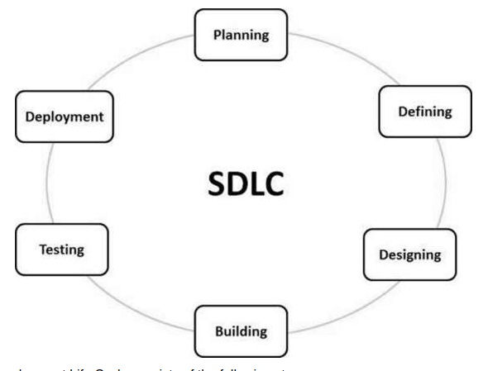
Software Development Lifecycle
A typical Software Development Life Cycle consists of the following stages:
Planning and Requirement Analysis
Defining Requirements
Designing the Product Architecture
Building or Developing the Product
Testing the Product
Deployment in the Market and Maintenance
Notes:
https://www.tutorialspoint.com/sdlc/sdlc_overview.htm

Slide 5
SDLC Approaches
There are two core software development life cycle models:
Heavyweight (predictive)
Heavyweight processes imply that the scope of work is predefined in advance. That’s why they are also called predictive. They require a significant contribution from the programmers and weighty documentation. Traditionally, companies chose a heavyweight approach for streamlining and organizing extensive projects.
Lightweight (agile)
Lightweight or agile processes, also called adaptive. They are a good compromise between overly strict discipline and its total absence. Agile methodologies require a much smaller amount of documentation in terms of a software life cycle.
Notes:
https://existek.com/blog/sdlc-models/#:~:text=There%20are%20so%20many%20different,to%20creating%20a%20successful%20product.

Slide 6
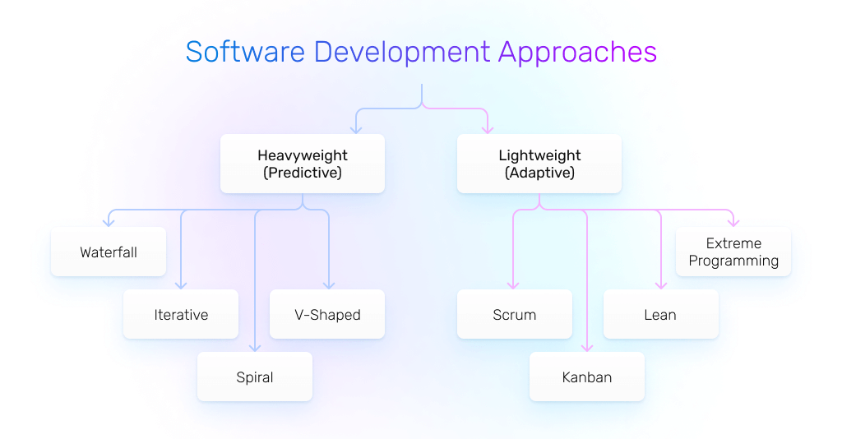
SDLC Approaches

Slide 7
Predictive SDLC Models
Predictive (heavyweight) models:
Waterfall
Iterative
Spiral
V-shaped
There are many more options, but these are the most common ones.

Slide 8
Adaptive SDLC Models
Among different SDLC models and methodologies, adaptive (agile) are the brightest candidates nowadays. The agile approach opens up new possibilities for specialists, enables more flexibility, and puts the communication between people ahead of the blind plan following.
Realizations of Agile models include:
Scrum
XP
Kanban

Slide 9
Waterfall vs Agile
Agile and Waterfall are two well-known project management methodologies. Both of them are popular in software development but each is best suited for different types of projects.
The main difference is that Waterfall is a linear system of working that requires the team to complete each project phase before moving on to the next one while Agile encourages the team to work simultaneously on different phases of the project.

Slide 10
Waterfall vs Agile: At a Glance
 | Waterfall | Agile
Approach | Goals and outcome established from the beginning | Frequent stakeholder interaction
Flexibility | Low | High
Requires | Completing deliverables to progress to the next phase | Team initiative and short-term deadlines
Notes:
https://www.forbes.com/advisor/business/agile-vs-waterfall-methodology/#:~:text=The%20main%20difference%20is%20that,different%20phases%20of%20the%20project.

Slide 11
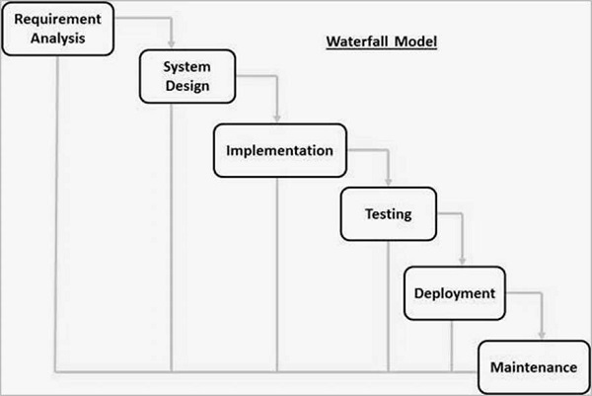
Waterfall Model Design
Requirement Gathering and analysis − All possible requirements of the system to be developed are captured in this phase and documented in a requirement specification document.
System Design − The requirement specifications from first phase are studied in this phase and the system design is prepared.
Implementation − With inputs from the system design, the system is first developed in small programs called units, which are integrated in the next phase.
Integration and Testing − All the units developed in the implementation phase are integrated into a system after testing of each unit.
Deployment of system − The product is deployed in the customer environment or released into the market.
Maintenance − There are some issues which come up in the client environment. To fix those issues, patches are released.
Notes:
https://www.javatpoint.com/software-engineering-waterfall-model

Slide 12
When to Use Waterfall?
Some Circumstances where the use of the Waterfall model is most suited are:
When the requirements are constant and not changed regularly.
A project is short
The situation is calm
Where the tools and technology used is consistent and is not changing
When resources are well prepared and are available to use.

Slide 13
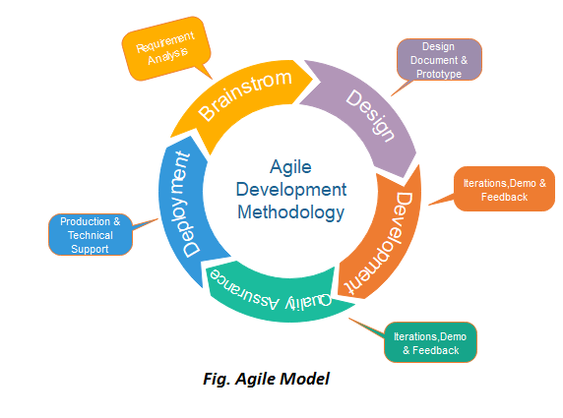
Agile Model Design
Requirements gathering - define the requirements. You should explain business opportunities and plan the time and effort needed to build the project
Design the requirements - identified the project, work with stakeholders to define requirements. You can use the user flow diagram or the high-level UML diagram to show the work of new features.
Construction/ iteration - Designers and developers start working on their project, which aims to deploy a working product.
Testing - Quality Assurance team examines the product's performance and looks for the bug.
Deployment - the team issues a product for the user's work environment.
Feedback - After releasing the product, the team receives feedback about the product and works through the feedback.

Slide 14
When to Use Agile Model?
When frequent changes are required.
When a highly qualified and experienced team is available.
When a customer is ready to have a meeting with a software team all the time.
When project size is small.

Slide 15
Scrum
SCRUM is an agile development process focused primarily on ways to manage tasks in team-based development conditions.
There are three roles in it, and their responsibilities are:
Scrum Master: The scrum can set up the master team, arrange the meeting and remove obstacles for the process
Product owner: The product owner makes the product backlog, prioritizes the delay and is responsible for the distribution of functionality on each repetition.
Scrum Team: The team manages its work and organizes the work to complete the sprint or cycle.
Notes:
Ini secara umum, sebenernya depends sama scale of company nya

Slide 16
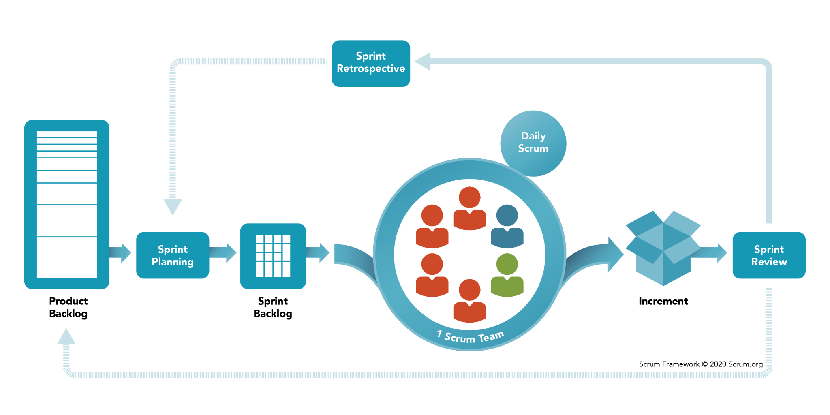
Scrum
Notes:
https://www.scrum.org/resources/what-is-scrum

Slide 17
Project Management Tools
Despite the name, project management tools are not just for project managers. Project management tools can be customized to fit the needs of teams of different sizes and with different goals.
Project management tools can include the following features:
Planning/scheduling: PM tools allow you to plan and delegate work in one place with tasks, subtasks, folders, templates, workflows, and calendars.
Collaboration: Email should not be your only form of communication — with project management tools, you can build a better way of working with your team: assign tasks, add comments, organize dashboards, and proof or approve changes.
Documentation: Avoid missing or outdated files with file management features that allow for editing, versioning, and storing files.
Evaluation: Track and assess productivity and growth through resource management and reporting.
Notes:
https://www.wrike.com/project-management-guide/faq/what-are-project-management-tools/

Slide 18
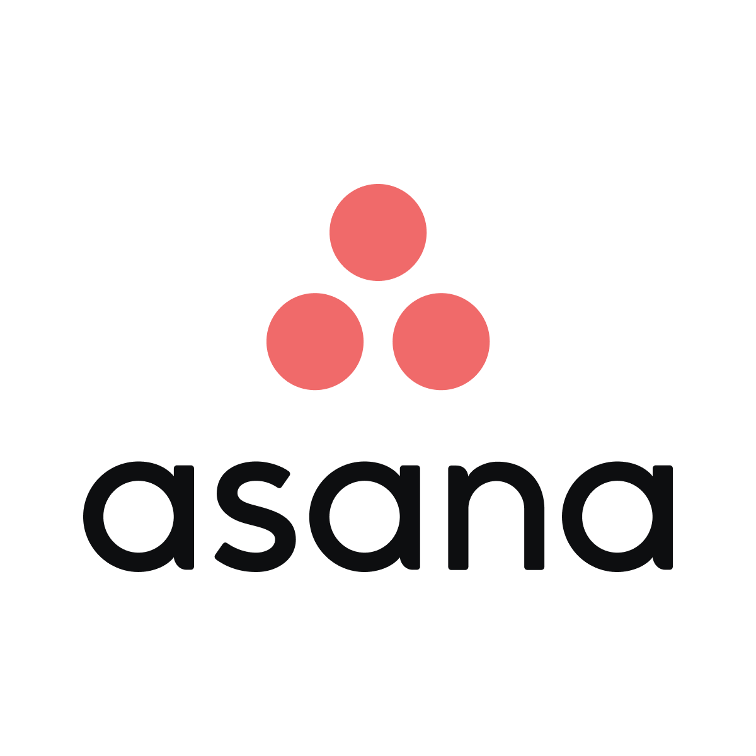


Project Management Tools
There are a lots of PM tools, here is the most common tools:
Jira
Trello
Asana

Slide 19
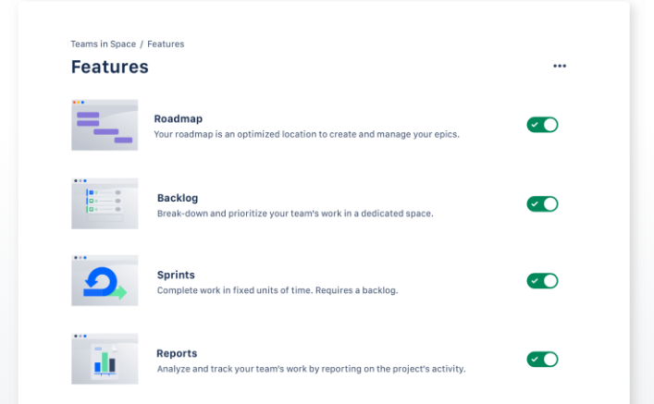
Jira Overview
Go to: https://www.atlassian.com/software/jira/
Notes:
Suruh bikin akun jira skalian udah bagi kelompok untuk ngerjain proyek terdiri dari 2 orang kalo sisa satu jadiin 3 di satu grup, trus praktekin sekalian kasih liat fitur2 nya

Slide 20
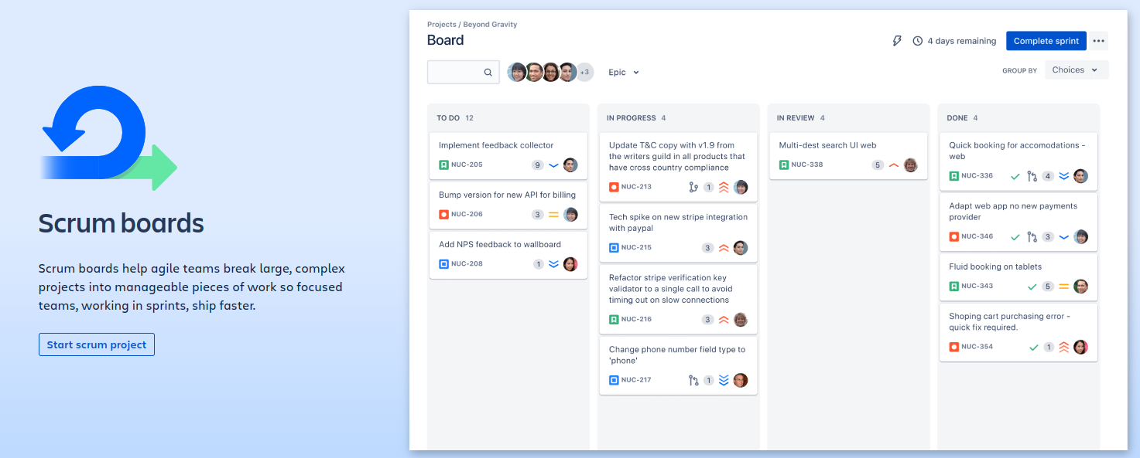
Jira Features
Go to: https://www.atlassian.com/software/jira/

Slide 21
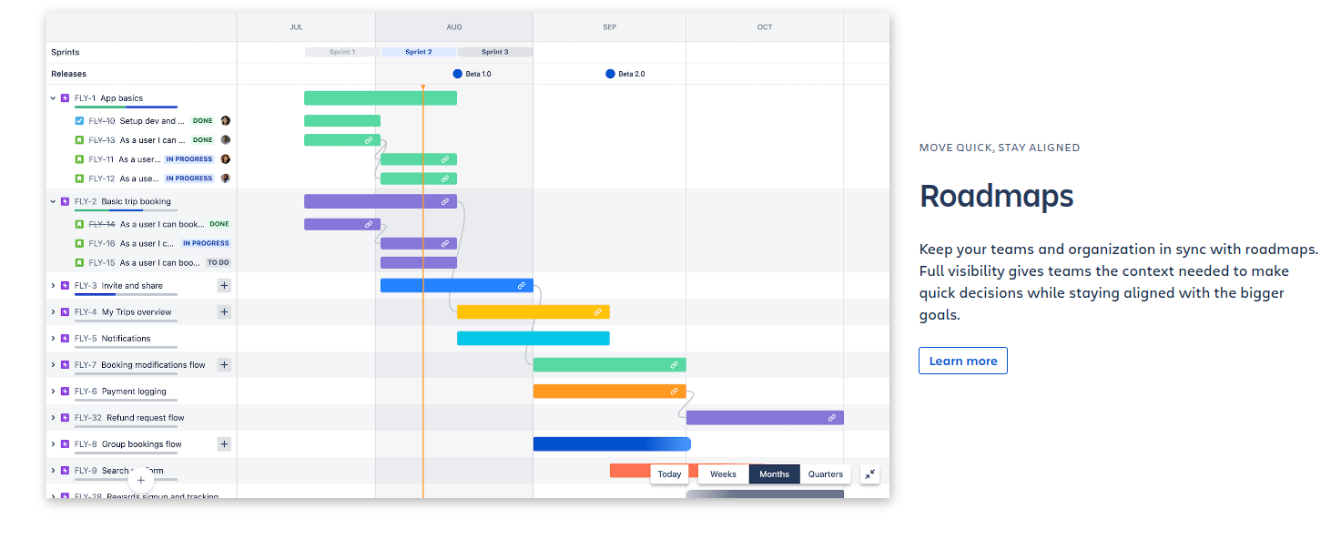
Jira Features
Go to: https://www.atlassian.com/software/jira/

Slide 22
What is Flowchart?
A flowchart is a diagram that depicts a process, system or computer algorithm. They are widely used in multiple fields to document, study, plan, improve and communicate often complex processes in clear, easy-to-understand diagrams.
Flowcharts, sometimes spelled as flow charts, use rectangles, ovals, diamonds and potentially numerous other shapes to define the type of step, along with connecting arrows to define flow and sequence. They can range from simple, hand-drawn charts to comprehensive computer-drawn diagrams depicting multiple steps and routes.
Notes:
https://www.lucidchart.com/pages/what-is-a-flowchart-tutorial/#discovery__top

Slide 23
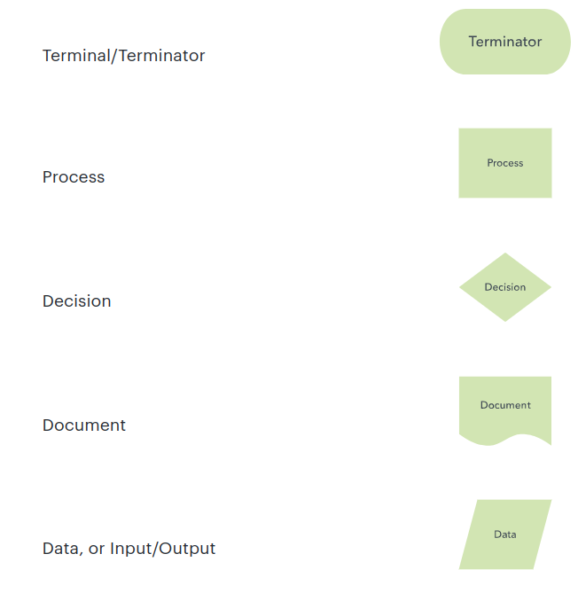
Flowchart Symbols

Slide 24
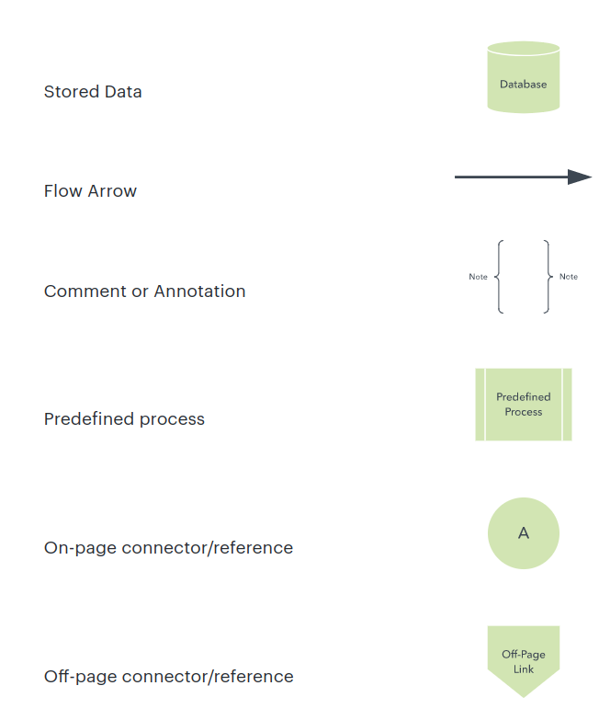
Flowchart Symbols

Slide 25
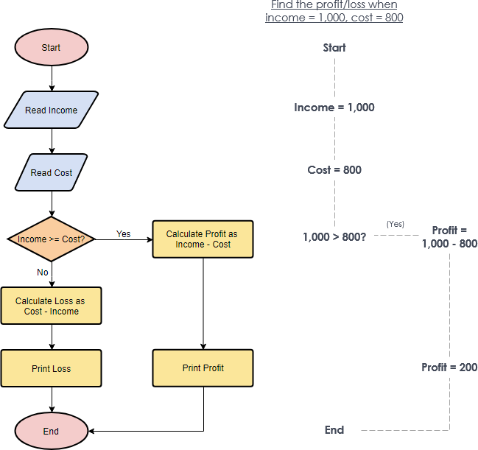
Example of FlowChart
Case:
Define loss or profit depends on income greater than cost.
Create online diagram:
https://app.diagrams.net/
Notes:
Implement flow chart based on spec yg bakal dikerjain

Slide 26
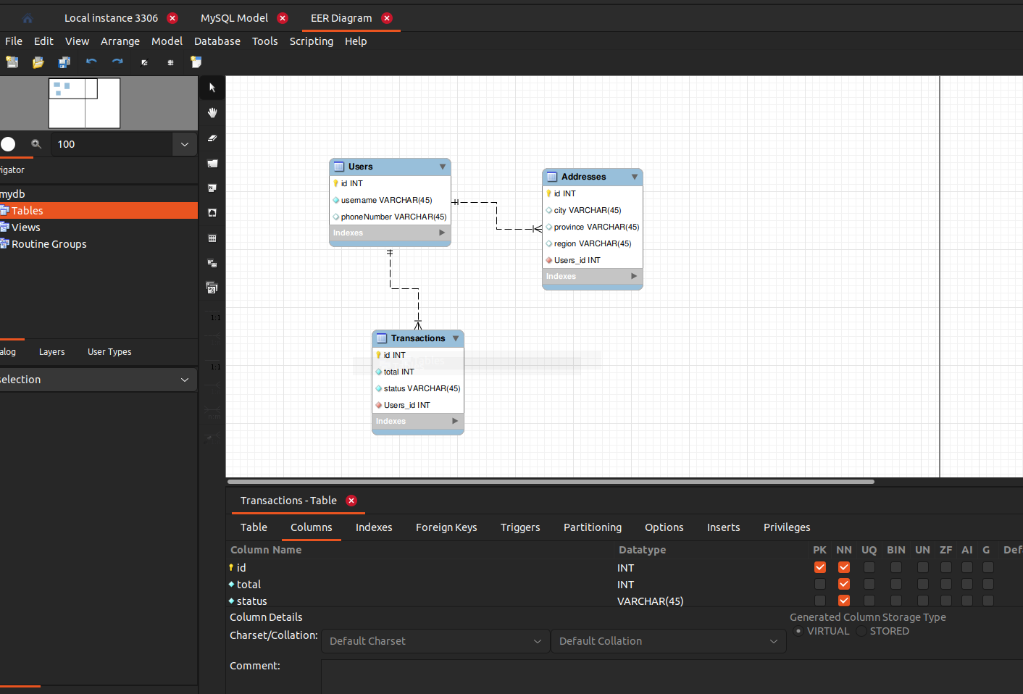
Database Design
Define which table you should use in the projects. Dont forget to define relations each of tables.
Notes:
Implement table apa aja yg bakal dipake dan relasi nya kayak apa

Slide 27
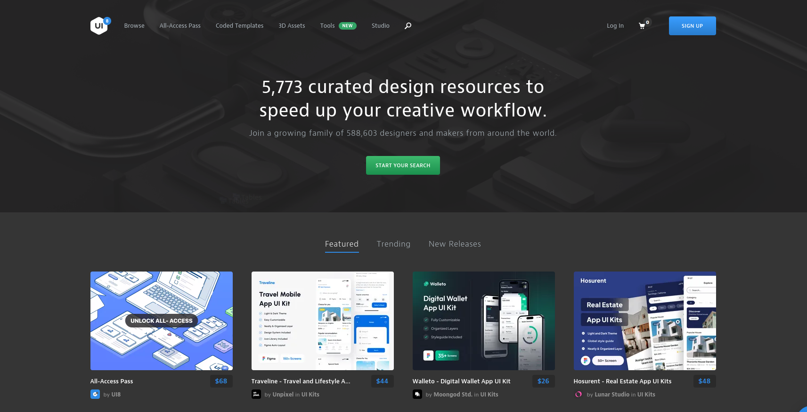
UI References
Behance
Dribbble
ui8
Notes:
Cari ui reference untuk project mereka

Slide 28
To-do List Task
List of task would be given in another file, in this case you will define each task that you would develop into your group projects.
Each task should be written in Jira!

Slide 29

Thank You!

